Slide 1
Develop for Changing Requirements with Custom Metadata Types
Daniel Hoechst | Enterprise Systems Architect | Instructure
dhoechst@gmail.com
@dhoechst
#BSD18

Slide 2



Where We’re Headed
Why use Custom Metadata Types?
What are Custom Metadata Types?
Using Custom Metadata in Code
Testing with Custom Metadata

Slide 3
Pop quiz!
What types of objects do we have in Salesforce?
Notes:
Let's start with a pop quiz. What types of objects do we have in Salesforce? I'll give you a hint. There are two of them.

Slide 4
Data Objects For the business Used by users
Metadata Types For the app Used by Admins
Notes:
Data and Metadata. Data objects are your accounts, your contacts, the stuff that's for the business and used by your end users. Your metadata types are the data for the app, and are used primarily by admins. Let's take a closer look.

Slide 5
 | Standard (Out of the Box) | Custom (Admins/Devs Build)
Data Objects For the business Used by users | Account | Building
 | Contact | Unit
 | Opportunity | Lease
Metadata Types For the app Used by Admins | Validation Rules | Lease Term Settings
 | Account Settings | Warranty Settings
 | Custom Object Translation | International VAT Rules
Notes:
Within data objects, we're all familiar with both standard objects like accounts, contacts, and opportunities, and custom objects, which are whatever data objects you or your admins build in your org to represent your specific operations. I work in the nonprofit space and do a lot with supported housing agencies, so here I might have buildings and apartment units, leases, etc. You might have a custom warranty or invoice object. Within metadata, we're all familiar with the standard types like validation rules or translation settings, but only in the last couple years have we had access to custom metadata types, whereby developers and admins can create their own metadata to drive app configuration. There are some examples up here in the yellow cells. If you're thinking these sound a lot like list custom settings, you're sort of right, but custom metadata types go way beyond what list custom settings can do.

Slide 6
Custom Metadata Types 2.0
Functionality | List Custom Settings | Custom Objects | Custom Metadata Types
Retrieve / deploy & package install records | ✗ | ✗ | ✔
Relationships between records | ✗ | ✔ | ✔
Relationships to Objects and Fields | ✗ | ✗ | ✔
Picklists, Long Text Area fields | ✗ | ✔ | ✔
Native Apex support to create and update records | ✔ | ✔ | ✔
Page Layouts | ✗ | ✔ | ✔
Validation Rules | ✗ | ✔ | ✔
Unlimited calls / queries | ✔ | ✗ | ✔
Setup audit trail history of records | ✗ | ✗ | ✔
Notes:
As you can see, Custom Metadata Types give you a lot more power over your app configuration than simple list custom settings. Hierarchy custom settings still have their place, but at this point, there's no excuse for using List Custom Settings anymore. Historically, lots of apps have also used hidden Custom Objects, but that leaves app configuration information in data, not metadata, which makes deployments and sandboxes challenging. Have you ever lost app configuration stored in a Custom Object on a sandbox refresh?
We will address a few more of these benefits of Custom Metadata in our demo, so let's keep going.

Slide 7
Custom Metadata Types 2.0 - Packaging
Functionality | List Custom Settings | Custom Objects | Custom Metadata Types
Package records | ✗ | ✗ | ✔
Protect (hide) the object | ✔ | ✗ | ✔
Protect (hide) individual records | ✗ | ✗ | ✔
Control over editability of fields | ✗ | ✗ | ✔
Notes:
Custom Metadata Types are also really powerful in managed packages; you get a lot of control over subscriber editability and visibility.

Slide 8
Custom Metadata Relationships
Relationships between a custom metadata type and the following metadata types:
Another custom metadata type
Entity definition
Field definition
Notes:
As of Spring '17, we have entity relationships on custom metadata. With the first version of CMDTs, developers had to use text fields and match api names based on strings. This got the job done, but was obviously quite error-prone. Now, we can look up directly to an Object or Field, or to another Custom Metadata Type. Let's take a look at what that looks like.

Slide 9
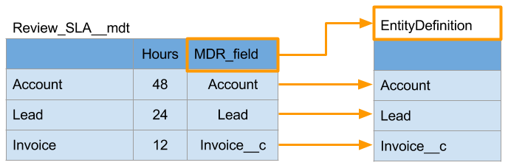
Custom Metadata Type and Entity Definition
Notes:
In this example, we have a Custom Metadata Type that stores review times under an SLA for different objects. An issue related to an Account has an SLA review time of 48 hours, an issue related to a Lead has a review time of 24 hours, and an issue related to an Invoice has a review time of 12 hours. That MDR field is not a text field – that's an entity relationship that looks up directly to an object. To be clear, that's not an Account *record* it's looking up to, that's the Account object itself. Likewise for Lead and Invoice. This is a prime example of a use case for custom metadata over just hard coding these numbers in your code. What if the SLA policies change? Would you rather have to go find references to these numbers in your code and fix them and update your tests and all thes rest? or would you rather let your org's admin simply update a few metadata records?

Slide 10
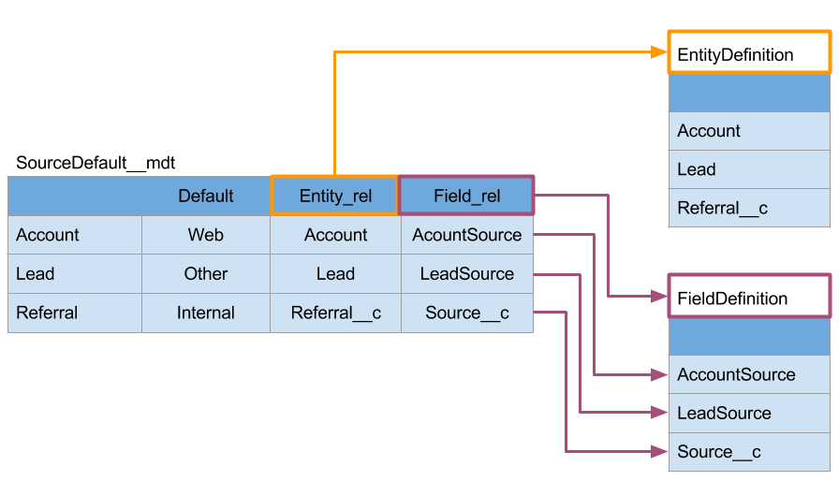
Metadata Type and Field Definition
Notes:
We can do this with fields, too. In this case, we have Custom Metadata records looking up to an object, that's the orange connection there, and then also looking up to a specific field on that object. Not a field value on a specific record, but the field itself as metadata.
Again, this used to be achieved with text fields and matching api names, but now we can use direct entity relationship lookups.

Slide 11
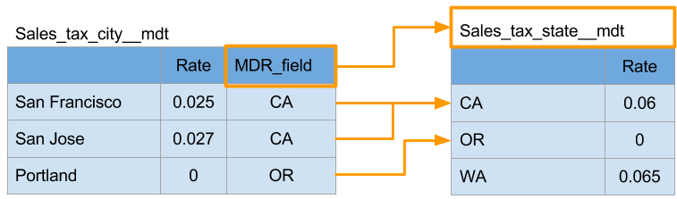
Two Custom Metadata Types
Notes:
Finally, we can also have entity relationships to records of other Custom Metadata Types. In this example, we have a City tax custom metadata type that has a lookup to a State tax custom metadata type. In Spring '18, we expect to also have self-lookups to records within a single custom metadata type as well. Of course, forward looking statement applies to that.

Slide 12
Demo
Creating a Custom Metadata Type
Notes:
Let's take a quick look at how easy it is to create a new Custom Metadata Type and give it a few records that can drive app configuration.

Slide 13
Using Custom Metadata Types in Code
Notes:
Now that we’ve talked about the mechanics of CMDTs and seen how they are an improvement over list custom settings, let’s look at how we can use them in a custom application. Daniel is going to walk us through how to retrieve metadata records and use them in our code.

Slide 14
Retrieving Custom Metadata Types
Doesn’t count toward Limits!
Notes:
First, let’s look at how to retrieve them. Those of you familiar with SOQL will notice we just use SOQL to retrieve them. There is one difference. Notice the __mdt? All custom fields will end with __c. The biggest difference between querying custom objects and CMDT is that when we retrieve our CMDT, we don’t count any of the queries in our SOQL limits and the metadata records are cached, so response should be faster.
Now let’s talk about how to retrieve multiple related CMDTs at the same time. Again, we can use SOQL, this time with a nested query to retrieve the parent and children at the same time. In this example, we are querying

Slide 15
Using Relationship Fields – Two Custom Metadata Types
Notes:
Now let’s talk about how to retrieve multiple related CMDTs at the same time. Again, we can use SOQL, this time with a nested query to retrieve the parent and children at the same time. In this example, we are querying all the States and nested in that are the rates for cities in each state.
Conversely we can use dot notation to query parent information. Here’s an example of how we can flatten out the cities.
Looks totally like SOQL but we are using the mdt suffix for the primary object.

Slide 16
Using Relationship Fields - Fields
Notes:
One of the cool things about CMDT is that they let us create relationship to entity definitions. This is great for making our code resilient to changing requirements. Let’s say one of the requirements is to put data into a field. The problem is that you as a developer may not know what field the business will want to use. Let’s see how to use a relationship to a field definition to dynamically get or set values in a field.
When we have a field lookup on a CMDT, Salesforce also gives us other bits of information about that field that we can use dot notation to get to field attributes such as Qualified API Name. We can then use that in dynamic Apex to get the value of the field on an object.
Look at FieldDefinition in Tooling API for all the field attribute possible. https://developer.salesforce.com/docs/atlas.en-us.api_tooling.meta/api_tooling/tooling_api_objects_fielddefinition.htm

Slide 17
Demo
Using Custom Metadata Types in an App

Slide 18
Testing with Custom Metadata Types
It is Metadata, so visible in test context!
But, wait, what about all my various permutations of configuration?

Slide 19
Demo
Using Mocking for Reliable Testing

Slide 20
Wrap Up
Use unique features of Custom Metadata Types to future proof and prevent code touches.
You can’t use them for everything, but almost! No more list custom settings!
Be careful with testing – use the stub API to inject mocking classes

Slide 21

But Wait One More Thing!
Custom Metadata Types can also be accessed from declarative tools (validation rules)

Slide 22

Next Steps
https://github.com/dhoechst/salesforce-custom-metadata-types
Custom Metadata Types on Trailhead

Slide 23
Q&A

